Slide 1
Shell Bootcamp 2024 3 Reflections for Week 2
Jallipalli Lakshmi Susmitha Jayasri
Date : 7-Sept-2024

Slide 2

About Me
“I am not a person who just completes the task, I enjoy the process and grow through it”
Please share an image / visual that best represents you

Slide 3

My learnings from this week!

Slide 4
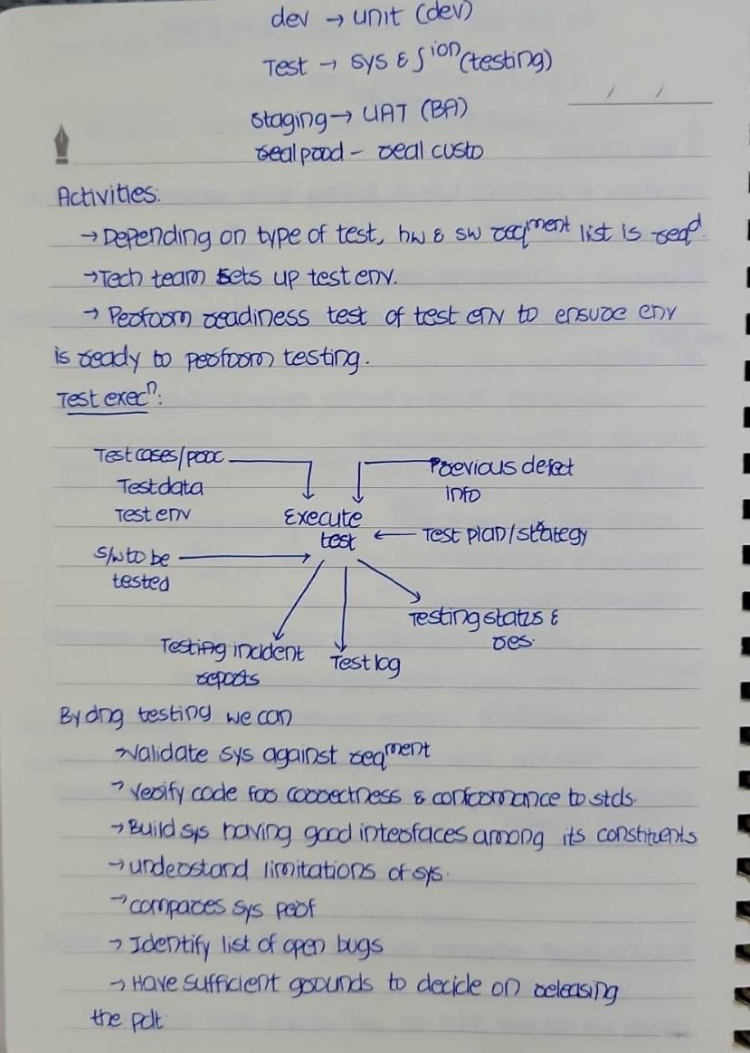
Learning 1 | My takeaways
Key Learnings: I have learnt testing and understood that it ensures reliability, functionality, quality of software by identifying and fixing issues early in the development process
Key takeaways: Testing is not a single phase; it is integrated into every phase of the SDLC and follows its own lifecycle(STLC) to ensure quality at every step
Shell implements testing through a risk based, automated approach; ensuring systems are secure, reliable, and compliant with industry standards. They focus on performance, safety, and security testing across all phases of development to maintain operational excellence
[Add a graphic that provides evidence of what you learned]

Slide 5
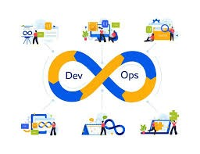
Learning 2 | My takeaways
Key learnings: I have learned devops and CI/CD. They promotes collaboration between development and operations, automating workflows
Key takeaways: DevOps and CI/CD streamline the development process, enabling faster, more reliable software releases with automated testing and monitoring
Shell likely adopts and CI/CD to automate workflows, reduce deployment time, and enhance collaboration.
[Add a graphic that provides evidence of what you learned]

Slide 6
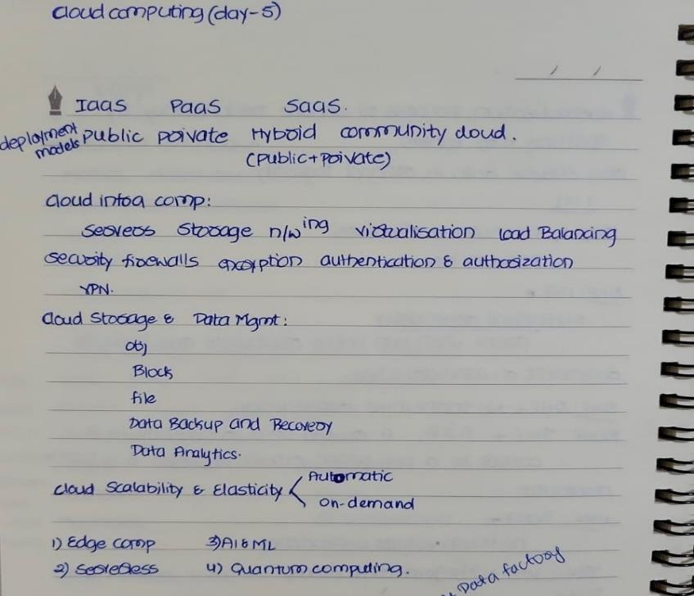
Learning 3 | My takeaways
Key learnings: I have learned Cloud and also DBMS which can be used for managing data and cloud enables fliexibility
Key Takeaways: Cloud computing is a game changing technology which enables us to use hardware as software and DBMS plays a very important role in managing the data
Shell uses cloud to scale its IT infrastructure, supporting real time data processing. And shell uses DBMS to manage the large amount of data that it deals with on a daily basis.
[Add a graphic that provides evidence of what you learned]

Slide 7

Relevance of learnings for my organization

Slide 8
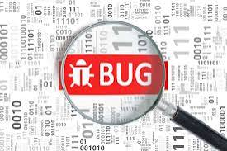
Learning 1 | Relevance for Shell
Shell implements comprehensive testing through automated and structured methodologies to ensure reliability, security and compliance across organisation
Shell benefits from this because it enhances operational efficiency, safeguards against vulnerabilities and supports regulatory compliance
[Add a graphic that provides view of how Shell implements this learning]

Slide 9
Learning 2 | Relevance for Shell
Shell’s devops implementation integrates development and operations for streamlined workflows, utilizing automation and cloud computing.
This approach accelerates time to market, enhances software quality and fosters collaboration, driving cost efficiency and adaptability in a dynamic market
[Add a graphic that provides view of how Shell implements this learning]

Slide 10

Learning 3 | Relevance for Shell
Shell predominantly uses Microsoft azure for its cloud needs, leveraging Azure’s services for scalable infrastructure, data storage and computing power
Benefits for Shell
Scalability
Cost efficiency
Enhanced data management
[Add a graphic that provides view of how Shell implements this learning]

Slide 11

Challenges in implementing learning

Slide 12
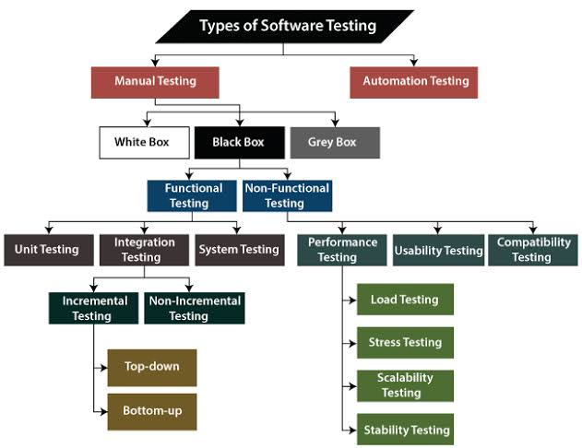
Challenge faced while implementing Learning 1
Challenge: There are many types of testing and it has been bit difficult to identify which one to use in which phase.
Plan: Study from web and other resources about testing to have more understanding on it

Slide 13
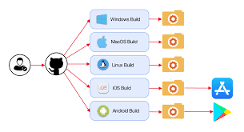
Challenge faced while implementing Learning 2
Challenge: Integrating github actions into CI/CD pipelines was complex. I was having difficulty in grasping yaml syntax
Plan: Kept trying until I get the flow of it and study from web resources
[Add a graphic that provides evidence of what you did to overcome this challenge]

Slide 14
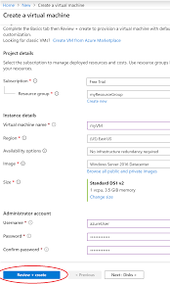
Challenge faced while implementing Learning 3
Challenge: I have difficulty in using Azure portal while creating VM as it is completely new website for me.
Plan: I kept exploring the Azure portal in my free time so that I would be familiarized with the website
[Add a graphic that provides evidence of what you did to overcome this challenge]

Slide 15

Action Plan

Slide 16
My Action Plan for this Week
Actions
Timeline
Status
Understand different types of testing and learn different tools used for testing
Have a hands on practice on azure devops
To be more clear about github actions
Read 30 minutes per day
Practice 20 minutes per day
Read 15 minutes per day
Have a clear understanding on why testing is important and how it ensures reliability of product
Got familiarized with azure devops
Have a clear overview on github actions

Slide 17

Learning is also Fun!

Slide 18

Learning is also Fun!
My facilitator for soft skills training Mrs Chaithanya has been very patient and made sessions very interactive and fun and also very informative. We had many activities to understand various concepts.
One of the group activity was to make aeroplanes out of paper in order to understand requirements. It was very fun and also informative. It explained we should never assume what client is expecting from a product we should ask him and be clear about it
[Add a graphic or a picture of how you/your team enjoyed the new learning]

Slide 19

Summary
Quick Summary:
As Shell is data driven company, DBMS and cloud plays a major role in managing the data.
Software testing ensures product quality which is crucial for delivering a high quality product.
Devops helps in accelerating delivery of product.

Slide 20
Thank You

